Slide 1
Properties of Regular Languages
Shakir Ullah Shah

Slide 2
Lecture Objective
Closure Properties
Complementation
Intersection

Slide 3
Closure Properties
A language that can be defined by a regular expression is called a regular language.
Not all languages are regular
In this lecture we will focus on the class of all regular languages and discuss some of their properties.

Slide 4
Theorem 10
If L₁ and L₂ are regular languages, then L₁ + L₂, L₁L₂, and L*₁ are also regular languages.
Notes:
L₁ + L₂ is the language of all words in either L₁ or L₂.
L₁L₂ is the product language of all words formed by concatenating a word form L₁ with a word from L₂.
L₁* is the language of all words that are the concatenation of arbitrarily many factors from L₁*.
The result stated in Theorem 10 is often expressed as “The set of regular languages is closed under union, concatenation, and Kleene closure”.

Slide 5
Proof by Machines
Because L₁ and L₂ are regular languages, there must be TGs that accept them (by Kleene’s theorem).
Let TG₁ accepts L₁ and TG₂ accepts L₂.
Assume that TG₁ and TG₂ each have a unique start state and a unique separate final state. If this is not the case originally, then we can modify the TGs so that this becomes true as in Kleene’s theorem, Part 2 of the proof

Slide 6
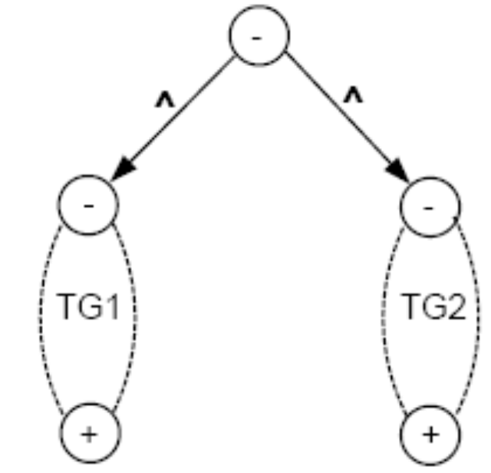
Proof contd.
Then the TG described below accepts the language L₁ + L₂.
By Kleene’s theorem, since L₁ + L₂ is defined by this TG, it is also defined by a regular expression and hence is a regular language.

Slide 7

The TG described below accepts the language L₁L₂ where state 1 is the former + of TG₁ and state 2 is the former - of TG₂.
Since L₁L₂ is defined by this TG, it is also defined by a regular expression by Kleene’s theorem, and therefore it is a regular language.

Slide 8
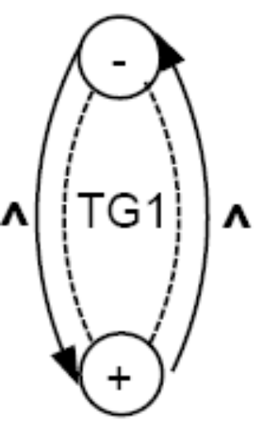
The TG described below accepts the language L₁*.
We begin at the - state and trace a path to the + state of TG1. At this point, we cold stop and accept the string or jump back, at no cost, to the - state and run another segment of the input string.

Slide 9
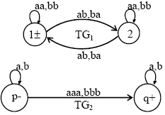
Example
Consider the following TGs

Slide 10
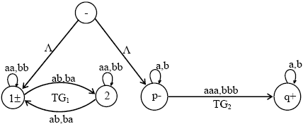
Example cont…
Following may be a TG accepting L₁+ L₂

Slide 11
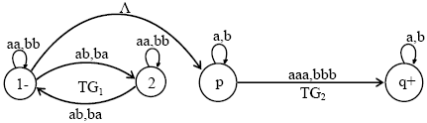
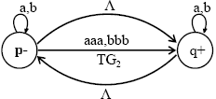
also a TG accepting L₁L₂ may be
and a TG accepting L₂*

Slide 12
Complements & Intersections

Slide 13
Complements
Definition:
If L is a language over the alphabet , we define its
complement L´ to be the language of all strings of letters from that are not words in L.
Example:
– Let L be the language over the alphabet ∑ = {a, b} of all words that have a double a in them.
– Then, L^{c} or L´ is the language of all words that do not have a double a in them.
Note that the complement of L´ is L. That is
(L´) ´ = L or (L^{c})^{c} = L

Slide 14
Theorem 11
If L is a regular language, then L^{c} is also a regular language. In other words, the set of regular languages is closed under complementation.

Slide 15
Proof of theorem 11
If L is a regular language, then by Kleene’s theorem, there is some FA that accepts the language L.
Some states of this FA are final states and some are not. Let us reverse the status of each state:
  If it was a final state, make it a non-final state.
  If it was a non-final state, make it a final state.
  The start state gets reversed as follows: - ↔ ±
If an input string formerly ended in a non-final state, it now ends in a final state, and vice versa.
The new machine we have just built accepts all input strings that were not accepted by the original FA, and it rejects all the input strings that used to be accepted by FA.
Hence using Kleene’s theorem L^{c} can be expressed by some RE. Thus L^{c} is regular.

Slide 16
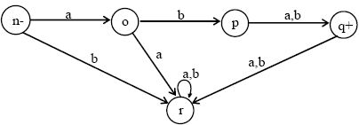
Example
Let L be the language over the alphabet
Σ = {a, b}, consisting of only two words
aba and abb, then the FA accepting L may be

Slide 17
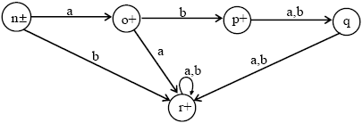
Example Cont…
Converting final states to non-final states and old non-final states to final states, then FA accepting L^{c} may be

Slide 18
Intersection: Theorem 12
If L₁ and L₂ are regular languages, then L₁ ∩ L₂ is also a regular language. In other words, the set of regular languages is closed under intersection.

Slide 19
Proof of Theorem 12
By DeMorgan’s law (for sets of any kind):
L₁ ∩ L₂ = (L´₁ + L´₂) ´
This means that the language L₁ ∩ L₂ consists of all words that are not in either L´₁ or L´₂.
Because L₁ and L₂ are regular, then so are L´₁ and L´₂ by Theorem 11.
Since L´₁ and L´₂ are regular, so is L´₁ + L´₂ by Theorem 10.
Now, since L´₁ + L´₂ is regular, so is (L´₁ + L´₂) ´ by Theorem 11.
This means L1 ∩ L2 is regular, because
L1 ∩ L2 = (L´₁ + L´₂) ´ by DeMorgan’s law.

Slide 20
Example
Consider two regular languages L₁ and L₂ , defined over the alphabet Σ = {a, b}, where
L1 = language of words with double a’s.
L2 = language of words containing even number of a’s.
FAs accepting languages L₁ and L₂ may be as follows

Slide 21


Example Cont….
FA₁
FA₂

Slide 22
Example Cont….
Their corresponding REs may be
  r₁ = (a+b)*aa(a+b)*
  r₂ = ( b + ab*a )*
Now FAs accepting L₁^{c} and L₂^{c}, by definition, may be

Slide 23
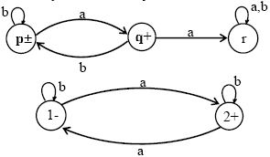
Example Cont….
FA₁^{c}
FA₂^{c}
Now FA accepting L₁^{c} U L₂^{c}, using the method described earlier, may be as follows

Slide 24
Example Cont….
Old states | New states after reading
 | a | b
z₁± ≡ (p, 1) | (q, 2) ≡ z₄ | (p, 1) ≡ z₁
z₂ + ≡ (p, 2) | (q, 1) ≡ z₃ | (p, 2) ≡ z₂
z₃ + ≡ (q, 1) | (r, 2) ≡ z₆ | (p, 1) ≡ z₁
z₄ + ≡ (q, 2) | (r, 1) ≡ z₅ | (p, 2) ≡ z₂
z₅ ≡ (r, 1) | (r, 2) ≡ z₆ | (r, 1) ≡ z₅
z₆ + ≡ (r, 2) | (r, 1) ≡ z₅ | (r, 2) ≡ z₆

Slide 25
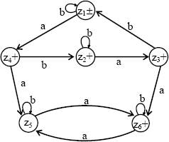
Example Cont….
Here all the possible combinations of states of FA₁^{c} and FA₂^{c} are considered
Old states | New states after reading
 | a | b
z₁± ≡ (p, 1) | (q, 2) ≡ z₄ | (p, 1) ≡ z₁
z₂ + ≡ (p, 2) | (q, 1) ≡ z₃ | (p, 2) ≡ z₂
z₃ + ≡ (q, 1) | (r, 2) ≡ z₆ | (p, 1) ≡ z₁
z₄ + ≡ (q, 2) | (r, 1) ≡ z₅ | (p, 2) ≡ z₂
z₅ ≡ (r, 1) | (r, 2) ≡ z₆ | (r, 1) ≡ z₅
z₆ + ≡ (r, 2) | (r, 1) ≡ z₅ | (r, 2) ≡ z₆

Slide 26
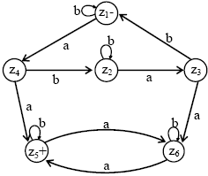
Example Cont….
An FA that accepts the language (L₁^{c} U L₂^{c} )^{c} = L₁ ∩ L₂ may be

Slide 27
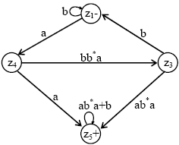
Example Cont….
Corresponding RE can be determined as follows
The regular expression defining the language L₁∩ L₂ can be obtained, converting and reducing the previous FA into a GTG as after eliminating states z₂ and z₆

Slide 28
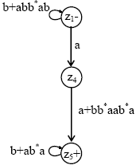
Example Cont….
after eliminating state z₃

Slide 29


Example Cont….
z₄ can obviously be eliminated as follows
eliminating the loops at z₁ and z₅
Thus the required RE may be (b+abb*ab)*a(a+bb*aab*a) (b+ab*a)*

Slide 30
FA corresponding to intersection of two regular languages (short method)
Let FA₃ be an FA accepting L₁ ∩ L₂, then the initial state of FA₃ must correspond to the initial state of FA₁ and the initial state of FA₂.
Since the language corresponding to L₁ ∩ L₂ is the intersection of corresponding languages L₁ and L₂ , consists of the strings belonging to both L₁ and L₂ , therefore a final state of FA₃ must correspond to a final state of FA₁ and FA₂.
Following is an example regarding short method of finding an FA corresponding to the intersection of two regular languages.

Slide 31


Example
Let r1 = (a+b)*aa(a+b)* and FA1 be
also r2 = (b+ab*a)* and FA2 be
An FA corresponding to L₁ ∩ L₂ can be determined as follows

Slide 32
Example Cont….
Old states | New states after reading
 | a | b
Z₁- ≡ (p, 1) | (q, 2) ≡ z₄ | (p, 1) ≡ z₁
z₂ ≡ (p, 2) | (q, 1) ≡ z₃ | (p, 2) ≡ z₂
z₃ ≡ (q, 1) | (r, 2) ≡ z₆ | (p, 1) ≡ z₁
z₄ ≡ (q, 2) | (r, 1) ≡ z₅ | (p, 2) ≡ z₂
z₅ + ≡ (r, 1) | (r, 2) ≡ z₆ | (r, 1) ≡ z₅
z₆ ≡ (r, 2) | (r, 1) ≡ z₅ | (r, 2) ≡ z₆

Slide 33
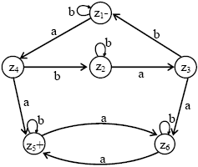
Example Cont….
The corresponding transition diagram may be as follows:
Old states | New states after reading
 | a | b
Z₁- ≡ (p, 1) | (q, 2) ≡ z₄ | (p, 1) ≡ z₁
z₂ ≡ (p, 2) | (q, 1) ≡ z₃ | (p, 2) ≡ z₂
z₃ ≡ (q, 1) | (r, 2) ≡ z₆ | (p, 1) ≡ z₁
z₄ ≡ (q, 2) | (r, 1) ≡ z₅ | (p, 2) ≡ z₂
z₅ + ≡ (r, 1) | (r, 2) ≡ z₆ | (r, 1) ≡ z₅
z₆ ≡ (r, 2) | (r, 1) ≡ z₅ | (r, 2) ≡ z₆

Slide 34
For each of the following pairs of regular languages, find an FA that each define L1 ∩ L2 and convert into a Regular Expression
 | L1 | L2
1 | (a+b)*a | b(a+b)*
2 | (a+b)*a | (a+b)*aa(a+b)*
3 | (a+b)*a | (a+b)*b
4 | (a+b)b(a+b)* | b(a+b)*
5 | (a+b)b(a+b)* | (a+b)*aa(a+b)*
6 | (a+b)b(a+b)* | (a+b)*b
7 | (b+ab)*b(a+Ʌ) | (a+b)*aa(a+b)*
8 | (b+ab)*b(a+Ʌ) | (b+ab*a)*ab*
9 | (b+ab)*b(a+Ʌ) | (a+ba)*a
10 | (ab*)* | b(b+ab)*
11 | (ab*)* | a(b+ab)*
12 | (ab*)* | (a+b)*aa(a+b)*
13 | (aa+ab+ba+bb)* | b(b+ab)*
14 | (aa+ab+ba+bb)* | (a+b)*aa(a+b)*
15 | (aa+ab+ba+bb)* | (b+ab)*a(a+Ʌ)
16 | (aa+ab+ba+bb)* | a(a+b)*

